Slide 1

Chapter 11
Section 2
Were They Present?
Notes:
This chapter goes over the evidence that shows the gospel writers were there to witness the events they write about Here are a few quotes from skeptics with objections that you’ll hear… (next slide)

Slide 2
What you’ll hear
“Why was the tomb supposedly empty? I say supposedly because, frankly, I don’t know that it was. Our very first reference to Jesus’ tomb being empty is in the Gospel of Mark, written forty years later by someone living in a different country who had heard that it was empty. How would he know?”
—Bart Ehrman, New Testament scholar, professor of religious studies, and author of Jesus Interrupted
Notes:
Bart Ehrman believes Jesus existed, but does not believe the resurrection and miracle claims about Jesus

Slide 3
What you’ll hear
“The so-called Gospel of John is something special and reflects … the highly evolved theology of a Christian writer who lived three generations after Jesus.”
—Geza Vermes, scholar, historian, and author of The Changing Faces of Jesus (published in year 2000)
Notes:
He thinks that the Jesus in the gospels is not the Jesus of the 1st century Jesus

Slide 4
What you’ll hear
“No work of art of any kind has ever been discovered, no painting, or engraving, no sculpture, or other relic of antiquity, which may be looked upon as furnishing additional evidence of the existence of these gospels, and which was executed earlier than the latter part of the second century.”
—Charles Burlingame Waite, historian and author of History of the Christian Religion to the Year Two Hundred (published in 1881)
Notes:
The quote suggests that if paintings and sculptures are based on a lie, no amount of them made will make the lie true.

Slide 5
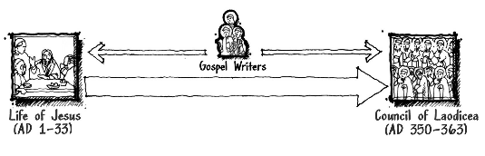
Are they late?
If late, the gospels are a lie (late works of fiction)
Were the gospel writers there?
We will trace through the evidence from the beginning

Slide 6
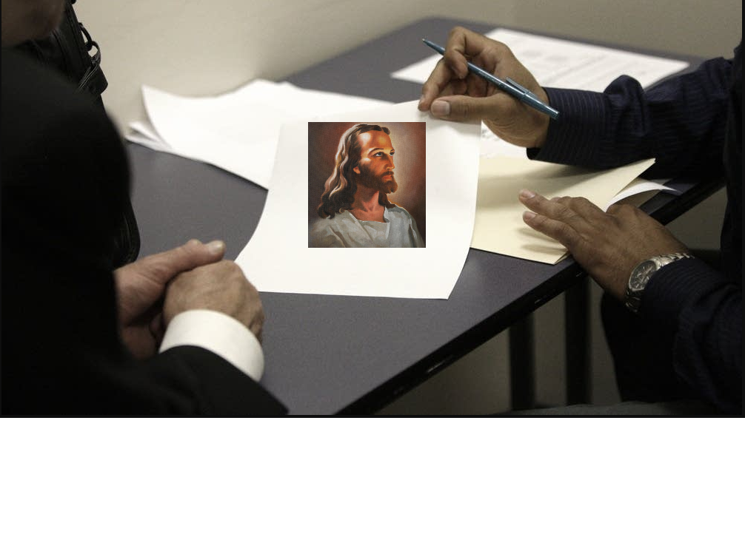
First, did they say they were eyewitnesses?
John claims that he saw Jesus with his own eyes (1 John 1:1-3)
Peter says he witnessed the sufferings of Christ (1 Peter 5:1)

Slide 7

Evidence by Omission
What is not mentioned can be just as important as what is mentioned.
No mention of AD 70 destruction of temple
Jesus predicted the temple would be destroyed
Notes:
Jesus predicted the temple would be destroyed, so it would be to be benefit of the gospel writers to record if it happened.
Every Jew would be very closely tuned to such an event happening.
Not only that, the Romans did a long siege before destroying it.
That would have been significant to note.
Even before the temple was destroyed, the city of Jerusalem was under assault.
Titus surrounded the city with four large groups of soldiers and eventually broke through the city’s “Third Wall” with a battering ram.
Roman soldiers eventually set fire to the city’s walls, and the temple was destroyed as a result.
No gospel mentions the 3 year siege and the suffering and agony that resulted on the Jewish people

Slide 8

Luke – Omission of deaths
Luke said nothing about these deaths
AD 64 – apostle Paul martyred
AD 65 – Peter martyred
Ad 62 – James the half brother of Jesus martyred (was leader of Jerusalem church)
Paul was the main character in Acts
Peter was a major leader of the early church
James was the leader of the early church at Jerusalem
Notes:
Acts 15:13 mentions James the half brother of Jesus
In Acts, Luke has Paul is the main character, yet does not mention his death.

Slide 9
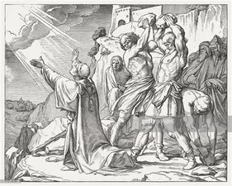
Luke - includes these deaths
Stephen (Acts 7:54-60)
James the brother of John (Acts 12:1-2)
Notes:
Luke both mentioned and omitted deaths.
If Luke mentions the death of a deacon, who is not as well known as an apostle, wouldn’t Luke reasonably have mentioned if an apostle was martyred?
So what is the best inference? (next slide)...

Slide 10
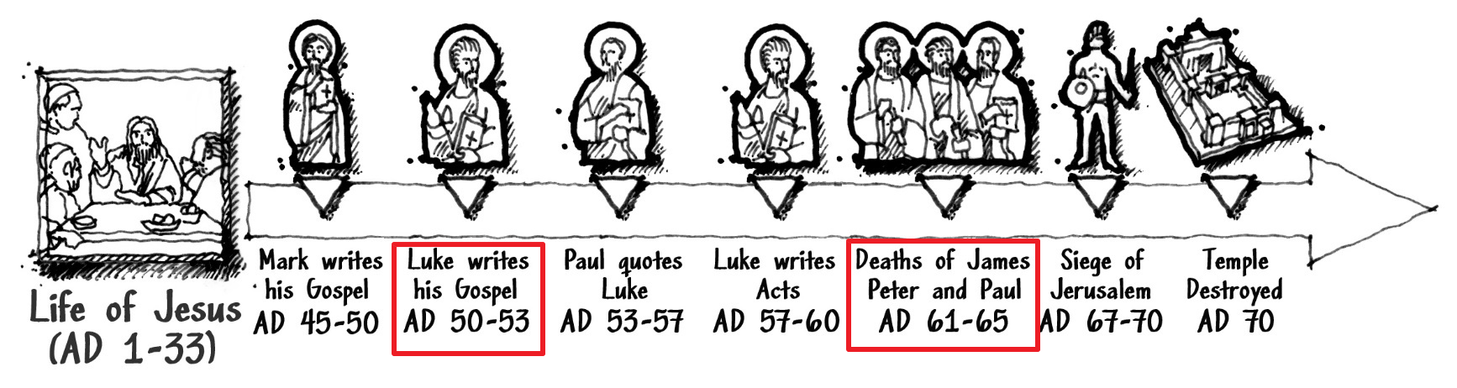
Inference based on internal corroborating evidence?
Luke was written before the martyrdom of Paul, Peter, and James the half brother of Jesus

Slide 11
Luke predates Acts
Luke addresses a “Theophilus” in Acts and mentions he had a prior “first account”
Acts 1:1-2 – “The first account(Luke) I composed, Theophilus, about all that Jesus began to do and teach, ...”
So Luke’s first gospel was Luke.
2nd was Acts
Notes:
Luke used this same type of verbiage to a fellow by the name of Theophilus in the beginning of the gospel of Luke. Both Luke and Acts are addressed to a “Theophilus”

Slide 12
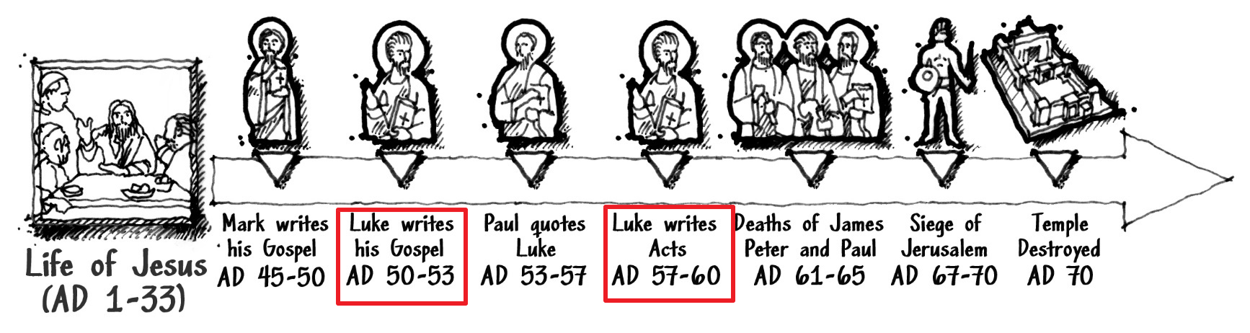
Luke before Acts
Based on Theophilus reference

Slide 13
Paul’s letter to Timothy
AD 63-64 – Apostle Paul wrote this to Timothy: “The elders who rule well are to be considered worthy of double honor, ... For the Scripture says, “You shall not muzzle the ox while he is threshing,” (Deut 25:4)
and
“The laborer is worthy of his wages.” (1 Timothy 5:17-18).
The 2nd quote is from Luke 10:7
Paul wrote as if the phrase he quoted was common knowledge at the time (having not cited the reference)
The apostle Paul considered the Luke’s gospel to be scripture when writing his epistles to Timothy

Slide 14
Paul echoed claims of gospel writers. Story didn’t change
AD 53-57 For I delivered to you as of first importance what I also received, that Christ died for our sins according to the Scriptures, and that He was buried, and that He was raised on the third day according to the Scriptures, and that He appeared to Cephas, then to the twelve. After that He appeared to more than five hundred brethren at one time, most of whom remain until now, but some have fallen asleep; then He appeared to James, then to all the apostles; and last of all, as to one untimely born, He appeared to me also. (1 Cor. 15:3–8)
Notes:
The mid-50’s is what even most skeptical scholars agree with for Paul writing Romans, Corinthians, and Galatians
------------------------------------------------------------------------
Most skeptical scholars agree that Paul is the author of Romans, Corinthians, and Galatians and have them dated between AD 48 and 60.

Slide 15
Galatians gives timelines
AD 50’s But when God, who had set me apart even from my mother’s womb and called me through His grace, was pleased to reveal His Son in me so that I might preach Him among the Gentiles, I did not immediately consult with flesh and blood, nor did I go up to Jerusalem to those who were apostles before me; but I went away to Arabia, and returned once more to Damascus. Then three years later I went up to Jerusalem to become acquainted with Cephas, and stayed with him fifteen days. But I did not see any other of the apostles except James, the Lord’s brother. (Gal. 1:15–19)
Then after an interval of fourteen years I went up again to Jerusalem with Barnabas, taking Titus along also. (Gal. 2:1)
Notes:
In Galatians, we can see that Paul met with the apostles Peter(Cephas) and James (the ½ bro of Jesus) within 3 years of his conversion, at least 14 years before writing Galatians.
It was definitely close enough to Jesus’ resurrection for there to still be 500 brethren who could confirm it
And a gutsy claim to make to readers who could have recognized such a claim if untrue.

Slide 16
Paul quotes Luke in 1 Cor
... and when He had given thanks, He broke it and said, “This is My body, which is for you; do this in remembrance of Me...” (1 Cor. 11:23–25)
Which means Luke must have come before 1 Corinthians was written
1 Corinthians is the only other gospel account that quotes the “do this in remembrance of me” phrase from the Lord’s supper
Luke must have been in common circulation for Paul to not feel it necessary to cite a reference to Luke with the quote.

Slide 17
Timeline so far
AD 33-36 – Paul’s conversion (most scholars agree)
+3 years – went to Arabia and Damascus
Visited Peter and James(Jesus bro)
+14 years
Puts Galatians at AD 50-53

Slide 18
Letters written after Luke
Luke > Acts/1 Cor/Galatians/1 Timothy
Notes:
Luke, then acts, then 1 cor/Gal, 1 Tim

Slide 19
Luke quotes Matt + Mark
(Luke 1:1–4) says: Inasmuch as many have undertaken to compile an account of the things accomplished among us, just as they were handed down to us by those who from the beginning were eyewitnesses ... having investigated everything carefully from the beginning, to write it out for you in consecutive order, most excellent Theophilus; so that you may know the exact truth about the things you have been taught.
Quotes 350 verses from Mark and 250 from Matthew
Notes:
Luke admits he is not the eyewitness to the life of Jesus,
but rather described himself as a historian
collecting statements from those who were.
.
It is reasonable to infer that Mark’s gospel was already
recognized, accepted, and available
when Luke was written.

Slide 20

Mark – early “Crime Broadcast”
Mark’s gospel was brief and focused on essential elements, leaving the details to be sorted out later
Some names of people are omitted because they are still alive and could be prosecuted
Notes:
An initial ‘crime broadcast’ consists of only the essential information needed to resolve the immediate problem at hand.
Perhaps a description of a getaway car or color of clothing a suspect was wearing, but not super descriptive.

Slide 21

Mark Omits Key Players
Arrest of Jesus. Omits Peter and Malchus (Mark 14:47)
Did not identify woman who anointed Jesus head at home of Simon the Leper (Mark 14:3-9)
Mark did not mention Jesus raising Mary’s brother Lazarus from the dead
Notes:
Mark seems to be protecting key players.
-Arrest:: Mark does not mention that it was Peter who cut off the high priest servant Malchus’ ear.
Perhaps Mark did not want to put Peter in harms way.
-Mark:: We know from John that it was Mary, the sister of Martha who poured the perfume on Jesus’ head, which could have been interpreted as her anointing Jesus as king, which the religious leaders would have found offense with.
The religious leaders already did not like that Lazarus was resurrected. Mark writing it down might have made Lazarus a target.

Slide 22
Papias’ description of Mark
Papias, an early church father said this about Mark:
Mark, having become the interpreter of Peter, wrote down accurately, though not indeed in order, whatsoever he remembered of the things said or done by Christ. For he neither heard the Lord nor followed him, but afterward, as I said, he followed Peter, who adapted his teaching to the needs of his hearers, but with no intention of giving a connected account of the Lord’s discourses, so that Mark committed no error while he thus wrote some things as he remembered them. For he was careful of one thing, not to omit any of the things which he had heard, and not to state any of them falsely.

Slide 23
Matthew + Luke attempted chronological accounts
Papias: “Therefore Matthew put the logia in an ordered arrangement in the Hebrew language, but each person interpreted them as best he could.”
Luke: It seemed fitting for me as well, having investigated everything carefully from the beginning, to write it out for you in consecutive order. (Luke 1:3)
Notes:
Contrasting Matthew + Luke, Mark had more of a urgent objective whereas Matthew and Luke wanted a more chronological order approach.

Slide 24
Gospel of John
Gospel of John likely written at a time when Peter, Malchus, and Mary were already dead.
Not uncommon for folks to add new evidence years later because threats to their testimony have been removed. (ie. Consider gang violence)
We have reasons to believe gospel of John was last, but not late...

Slide 25
Gospel of John
No exact date, but likely between Peter’s death and Temple destruction (AD 61-70)
John 21:20-23 Peter turned and saw the disciple whom Jesus loved(John) following them, ... When Peter saw him, he said to Jesus, “Lord, what about this man?” Jesus said to him, “If it is my will that he remain until I come, what is that to you? You follow me!” So the saying spread abroad among the brothers that this disciple was not to die; yet Jesus did not say to him that he was not to die, but, “If it is my will that he remain until I come, what is that to you?”
Notes:
This extra comment: Is most reasonable with john writing this after finding out about Peter’s death. Perhaps John felt what Jesus said needed more explanation, which is normal for eyewitnesses who testify after hearing the testimony of others. They try to clarify.

Slide 26
Gospel of John
John 5:2 “there is in Jerusalem, by the sheep-gate, a pool (the one called Bethesda in Hebrew) which has five porticoes.” John used the present tense word “is” (ἐστιν) when describing the existence of the pool, yet the pool was destroyed in 70AD when Jerusalem was sacked by the Romans.

Slide 27
Gospel of John
John calls the apostles “disciples”, using more familiar titles. John presumes you knew they were apostles.
Calls “John the Baptist” John as if readers already knew about John the Baptist from the other gospels.
John did not include passage where Jesus predicted destruction of the Jewish Temple.
If temple was destroyed when John was written, John likely would have mentioned the prophecy of Jesus about the temple.

Slide 28
Gospel of John
Does not take time to provide detail about each of Jesus disciples as other gospels do
Early church fathers testified that John’s gospel was written after the others.
John was last synoptic gospel written, but not late
Notes:
------------------------------------------------------------------------
(according to Eusebius’ History of the Church, Book 4, Chapter 14.7), and Irenaeus, the ancient Bishop of Lugdunum, also affirmed this to be the case (see Against Heresies, Book 3, Chapter 1). Later Church Fathers (like Origen, Eusebius, and Jerome) repeated this claim.

Slide 29
Skeptic Talking Points
Gospels were anonymous, therefore easy to forge
Gospels are not the only ancient documents that do not identify the author in the manuscript
Tacitus did not identify himself in his writings (AD 56-117)
Notes:
-Tacitus:: -Roman senator and historian under Nero
-Tacitus was present during much of this period of time, but failed to write about himself or identify himself as the author.
-Like the Gospels, Tacitus’s authorship is supported by other early writers attributing the writings to him.

Slide 30
Rebuttals to Forgeries
If someone made up who the authors were hundreds of years later, why pick Mark or Luke when they could have easily chosen Peter, Andrew, or James to make their writings seem for authoritative?
Mark and Luke admit they were not the eyewitnesses, but wrote what the eyewitnesses said.
No early church leader has ever attributed Mark, Matthew, Luke, or John to anyone other than the names we have today

Slide 31
The Temple Prophecy
Claim: Jesus’ prophecy of the temple destruction was inserted after the temple was destroyed.
Common tactic of philosophical naturalists.
Ignoring the evidence to fit a worldview(no miracles)
Gospel writers showed fulfillment of many other prophecies
If Jesus could predict His own resurrection and cite prophecies for it, predicting the temple was nothing.
Notes:
-Ignoring:: A common tactic of folks who do not believe the supernatural is possible is to automatically assume miracles cannot happen.
-Gospel:: Such as when Peter denied Jesus 3 times.
-If:: With the resurrection, the gospels repeatedly write about how amazing Jesus’ prediction was that He would raise Himself from the grave. -Why wouldn’t the gospel writers brag about Jesus predicting the temple destruction too, if they wrote this post 70 AD. The skeptic criticism is not consistent with the evidence.

Slide 32
“Form” criticism
Attempt to categorize parts of scripture based on “type”, “pattern”, or “form.
Parts of scripture that talk about miracles are categorized as a “form” that can then alleged to be late additions/insertions.
Theory fails to explain how miraculous “content” varies in literary style and form.
Criticism rooted in bias against supernatural

Slide 33
Bishop in Antioch: Theophilus
Critics say the “Theophilus” from Luke was the bishop of Antioch (AD 169 to 183). Luke was born in Antioch.
Luke addressed Theophilus as “most excellent” as if there was some position of leadership
If Theophilus was so ‘excellent’, why would he as a bishop of one of the largest cities in the Roman empire need a “consecutive order” so he could “know the exact truth about the things [he had] been taught”? Luke writes in a position of greater knowledge than Theophilus.

Slide 34
Then who was Theophilus?
No one knows for sure, but could be…
Theophilus is Greek for “Friend of God”. Luke was a Greek.
A Roman official. Luke only used “most excellent” when addressing Roman officials in his writings.
Notes:
-Theophilus:: Gospel account was for all those who were friends of God. -also consider that it seems odd to write all that effort in Luke’s gospel just for one person. Perhaps it was written for the masses. Friends of God.
-Or, “Friend of God” could have been an alias for someone in a high, Roman government position so as to not openly expose them as being a Christian
-A:: Luke himself provides three examples of this usage: the -letter of Lysias to the governor Felix (Acts 23:26), an -address to the same man by Tertullus (24:3), and -Paul’s speech to the governor Festus (26:25). -but Luke does not address Theophilus as “Most Excellent” in the book of acts; it could be that Theophilus was no longer in his position of authority anymore.

Slide 35
Theophilus?
A Jewish High Priest? Theophilus ben Ananus(Roman appointed. AD37+41) or Matthias ben Theophilus were alive around the time period.
Luke’s focus on the temple and Jewish customs related to the Sadducees could best be explained if one of these two priests was his intended audience.
Notes:
-since high priests were different year by year, it could be that Theophilus Ben Ananus, being a Roman appointed high priest was *excellent* one year for the gospel of Luke, and not high priest another year when Acts was written. -The fact that Luke goes into so much detail about Zechariah and his activity in the temple might explain why Luke wrote about how Joseph and Mary took Jesus to the temple and again when He was 12 years old. -Luke does not mention Caiaphas’ role in Jesus’ crucifixion perhaps because Caiaphas was Theophilus ben Ananus’ brother-in-law.

Slide 36
Theophilus
Possible he was the Bishop in Antioch from AD 169 to 183?
But not evidentially reasonable
Remember that Acts and several of Paul’s letters quote Luke

Slide 37
Objection: Luke copied off of Josephus, so Luke is “late”
Titus Flavius Josephus (AD37 to ~AD100)
Wrote “Antiquities of the Jews) in AD 90’s
Luke quoted passages from Matthew and Mark and did not make attempts to hide it. He did not quote passages from Josephus, nor are passages in Luke following Josephus’ writing style.
If Josephus has facts that are in Luke, then that helps to verify that Luke was telling the truth, not that Luke was a late gospel that copied off of Josephus.
Notes:
2.)Critics say Luke copied off Josephus (which would make gospel of Luke late, and a lie)
Possible Luke copied off of Josephus? But is it evidentially reasonable? no.

Slide 38
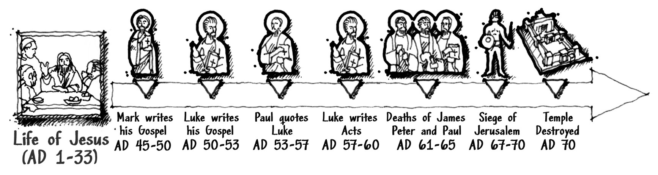
Reasonable inference from the circumstantial evidence.
Gospels were early, when witnesses alive.

Slide 39
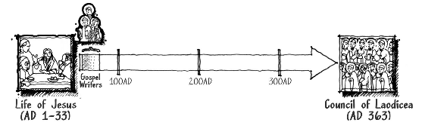
Early
Gospels were very early compared to the bible canon being formed at the Council of Laodicea.

Slide 40
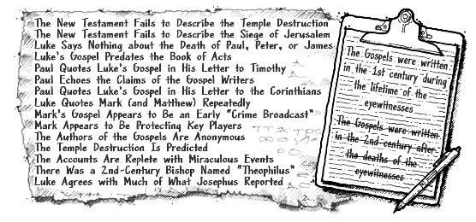
Overview of Evidence
Notes:
-The last 5 pieces of evidence support the 2nd inference based on the evidence, but has great difficulty in explaining how the first 11 pieces of evidence exist.
-The first 11 pieces of evidence is also based on evidence, except they are feasible, straightforward, and logical. They are a superior explanation to the last 5 pieces of evidence.
-The last 5 can’t explain the 1st 11, but the first 11 can explain the last 5 pieces of evidence.

Slide 41
We demonstrated that the gospel writers were present at the time period they are writing about, being able to see what they claimed to see
The gospels being early does not yet prove that the gospel writers claims are corroborated(agreed with) by internal and external evidence.
We look to see if the gospels are corroborated in the next lesson

Slide 42
for more information visit:
www.ColdCaseChristianity.com

